Slide 1
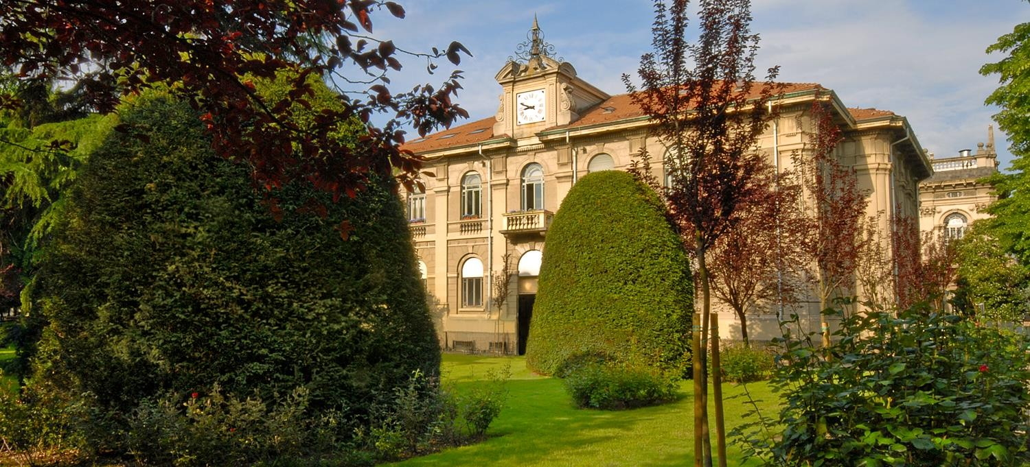

Image Analysis and Computer Vision Project (IACV)
EYE TRACKING AND GAZE ESTIMATION
AY 2019-2020
Bianco Luca 915240 Randazzo Lorenzo 905565

Slide 2


Problem formulation and solution approach
Eye tracking is the process of measuring the motion of an eye relative to the head. These measurements are carried out by a tracking algorithm, that records the position of useful image information and the movements they make. We exploited eye tracking to estimate the point of gaze (where the user is looking at the screen).
The goal was to show, how gaze estimation can provide assistance in the act of detecting, where the user is looking on the screen and monitoring how much he is focused in a certain area of it.
Eye_tracking is a Matlab program that localizes face features and plots the estimated gaze on the screen, using a Feature-Based approach.
Bianco-Randazzo Eye tracking and gaze estimation

Slide 3
State of the art
In the last three decades, active research has been carried out for eye tracking and gaze estimation under a desktop environment using a single, low cost web camera. In general, gaze estimation methods can be mainly categorized into two types: namely appearance-based methods and features-based methods.
Appearance-based gaze estimation methods take the whole eye image as an input and then construct mapping functions to gaze directions or the points of regard on a screen.
Unlike appearance-based methods, feature based methods estimate the gaze via extracting remarkable facial points such as eye corners, eye lids, pupil centers or corneal glints.
Bianco-Randazzo Eye tracking and gaze estimation

Slide 4
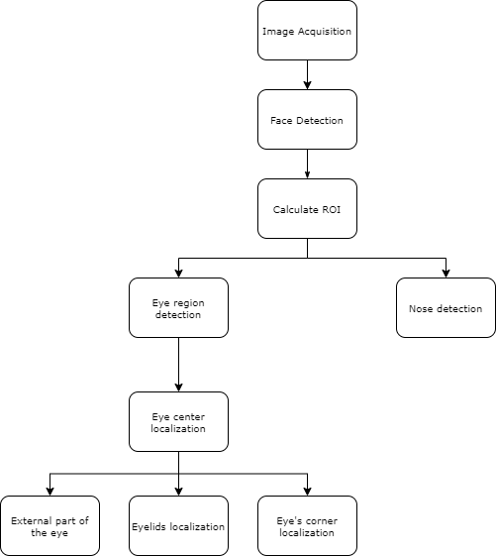
Solution approach and code flowchart
The main while loop is divided into three principal phases:
Detection;
Tracking;
Feature collecting and prediction;
Bianco-Randazzo Eye tracking and gaze estimation

Slide 5
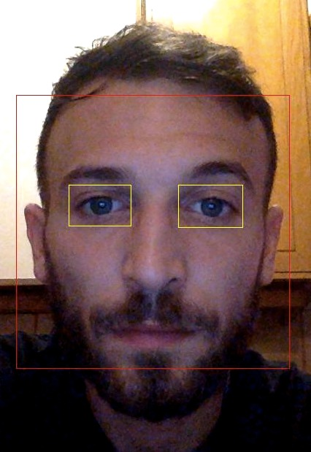
Solution approach - Detection
Once the face box is found, the localization of the eyes is performed in a limited Region Of Interest (ROI) defined with respect to the face box found in the previous step. For both cropped ROI images we perform the following steps. In the figure are shown the eye ROIs in yellow boxes and the face box in red.
After that, eyes center, eyelids, internal eye corners and external part of the eyes are calculated, and the tracking is initialised.
Bianco-Randazzo Eye tracking and gaze estimation

Slide 6
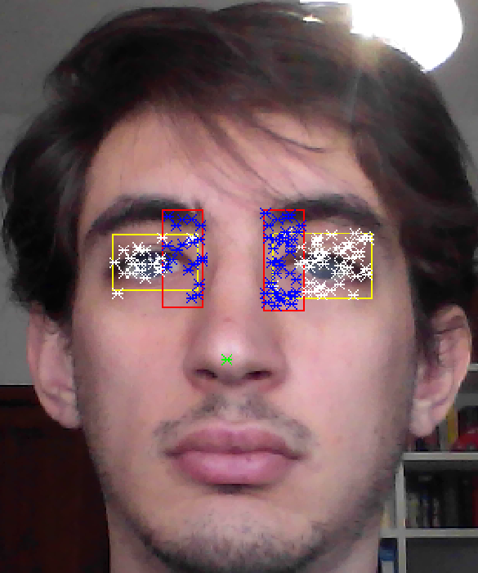
Solution approach - Tracking
So, when the detection is finished, eyes and nose need to be tracked frame by frame. To do this, we used the Matlab implementation of the Kanade-Lucas-Tomasi (KLT) tracking algorithm, using the detection features by Shi-Tomasi, as they are implemented in Matlab; thus five trackers are used.
The two tracker on the eyes and the two on the corners are initialized using the entire frame image and as region of interest found before while for the nose only one point is used. As the point tracker algorithm progresses over time, points can be lost due to lighting variation, out of plane rotation, or articulated motion. To solve this problem, the tracker is re-initialized when the visible points are less then the fixed threshold. From the tracked region of interest the desired points of interest are localized.
Bianco-Randazzo Eye tracking and gaze estimation

Slide 7
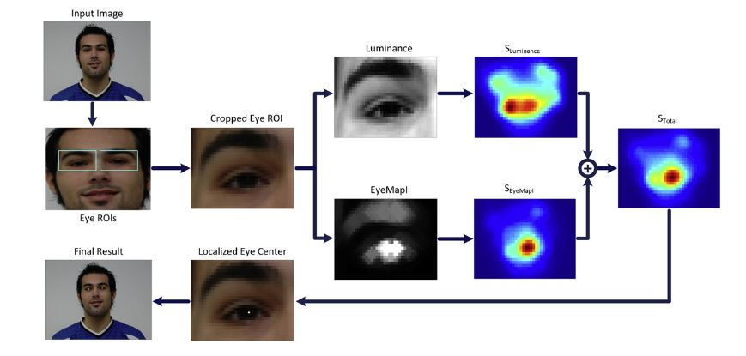
Localization – Eye centers
Given the region of interest from the Viola-Jones detection of the eyes, the localization of the eye centers is performed in a few steps. The image cropped, correspondent to the region of interest, is converted from RGB to YCbCr color space.
Color information and Fast-radial symmetry transform are used to localize the eye centers
Bianco-Randazzo Eye tracking and gaze estimation

Slide 8
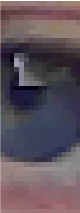

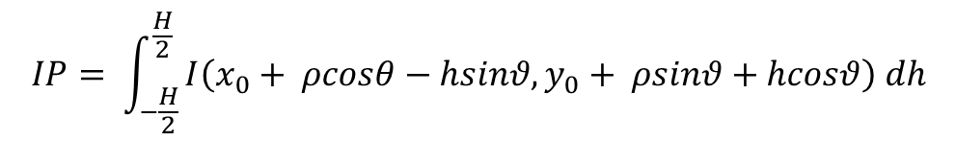
Localization – Eyelids
The x-position of the eyelids is regarded the same as those of the corresponding eye centers. Starting from the localized eye center we define a rectangular Region of Interest (ROI) in which the eyelids are searched, using heuristic parameters. Edges are searched in the cropped image using canny filter and the integral projection (generalized to detect projections on different angles) is used to look for the eyelids.
$$IP= \int_{−\frac{H}{2}}^{\frac{H}{2}}{I\left(x_{0}+ ρcosθ−hsinθ, y_{0}+ ρsinθ+hcosθ\right) dh}$$
Bianco-Randazzo Eye tracking and gaze estimation

Slide 9
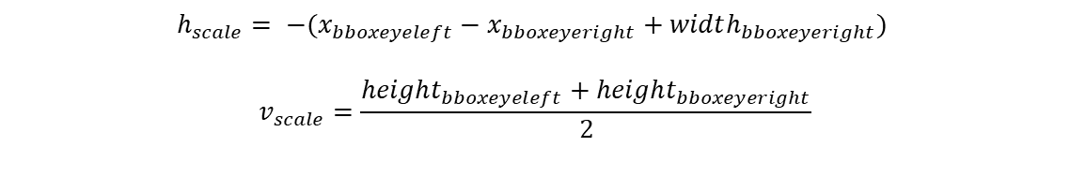
Gaze estimation – The model
Since the features are collected with a certain distance from the screen, an error could be learned from the features when the position relative to the screen is changing through the different calibration or the test; this means that changing the position from the screen will leads to a wrong gaze estimation. To avoid this problem, every time that a feature is collected, is then scaled. The scaling factors are different between horizontal and vertical features. The horizontal scale is the distance between the most far points of the eyes’ bboxes. The vertical scale is the mean height of the two eyes’ bboxes.
This approach leads to have better performance with different distances from the screen.
$$h_{scale}= −(x_{bboxeyeleft}−x_{bboxeyeright}+width_{bboxeyeright})$$
$$v_{scale}=\frac{height_{bboxeyeleft}+height_{bboxeyeright}}{2}$$
Bianco-Randazzo Eye tracking and gaze estimation

Slide 10
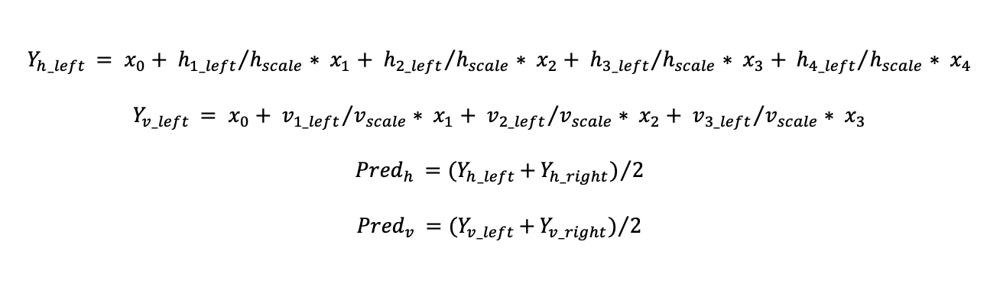
Gaze estimation – The model
For the estimation of the model a linear regression approach is used. Four mapping functions, one for each eye direction (along x and y axes), are used.
Given the assumption of independence of gaze estimation in the two axes, four separate feature vectors are formed as horizontal and vertical distances between moving and anchor points, two for each eye.
When the predictions are ready, the final gaze point is estimated horizontally as the mean between the horizontal predictions of each eye (Pred_{h}).
In the same way we estimate the vertical coordinate (Pred_{v}).
$$Y_{h_left }= x_{0}+ {h_{1_left}}/{h_{scale}}∗ x_{1}+ {h_{2_left}}/{h_{scale}}∗ x_{2}+ {h_{3_left}}/{h_{scale}}∗ x_{3}+ {h_{4_left}}/{h_{scale}}∗ x_{4}$$
$$Y_{v_left }= x_{0}+ {v_{1_left}}/{v_{scale}}∗ x_{1}+ {v_{2_left}}/{v_{scale}}∗ x_{2}+ {v_{3_left}}/{v_{scale}}∗ x_{3}$$
$${Pred}_{h }={(Y}_{h_left }+{Y_{h_right})}/2$$
$${Pred}_{v }={(Y}_{v_left }+{Y_{v_right})}/2$$
Bianco-Randazzo Eye tracking and gaze estimation

Slide 11
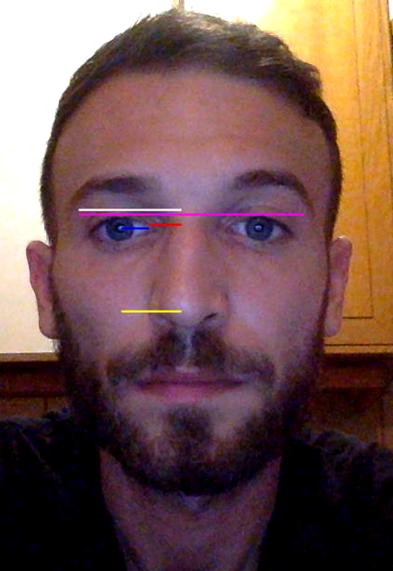
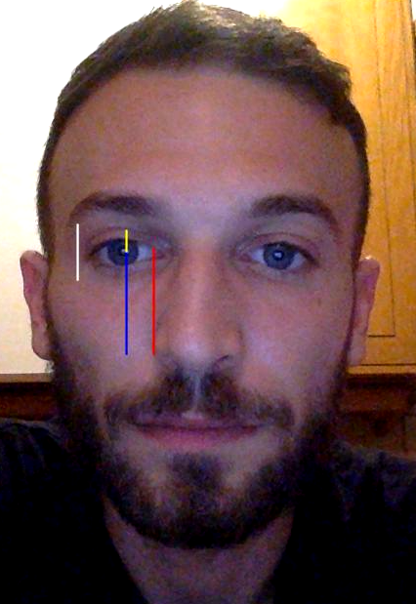
Gaze estimation – the collected features
Features for both eyes are calculated as the following in the two axes:
Horizontal features:
Horizontal distance between eye center and nose tip
Horizontal distance between eye center and eye corner
Horizontal distance between eye corner and nose tip
Difference between horizontal distances from outer eyes corner and nose tip
Vertical features:
Vertical distance between eye center and nose tip
Vertical distance between eye corner and nose tip
Vertical distance between upper eyelid and eye center
Bianco-Randazzo Eye tracking and gaze estimation

Slide 12
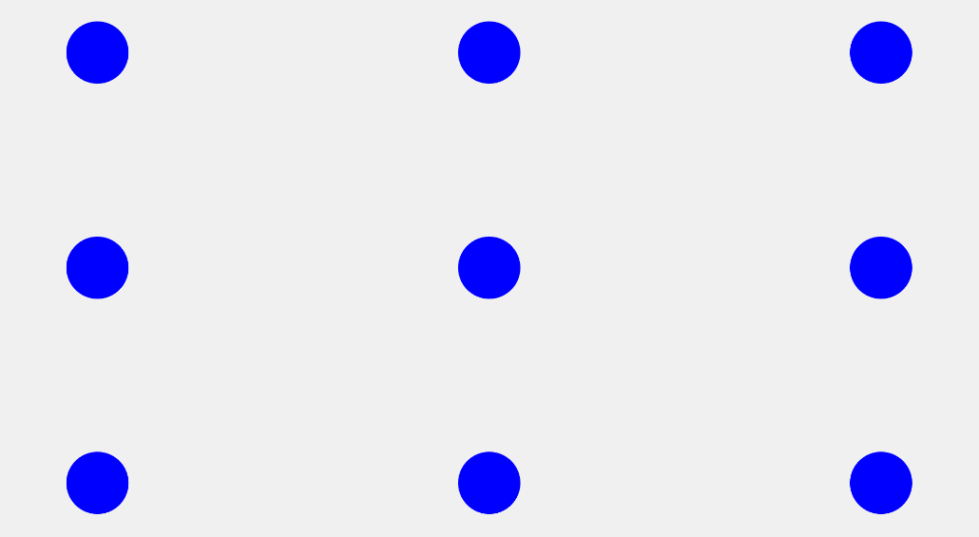

Calibration procedure
In the calibration phase the procedure consist in a window with some blue points moving on the screen. When a point is showed the user have to look at it until the final ‘bip’ is heard and the point move in the next position. The calibration pattern consists in 9 points placed in a square arrangement. Thereafter, the correspondences between the known points on the screen and their relative features, allows to train the linear regression model.
Bianco-Randazzo Eye tracking and gaze estimation

Slide 13
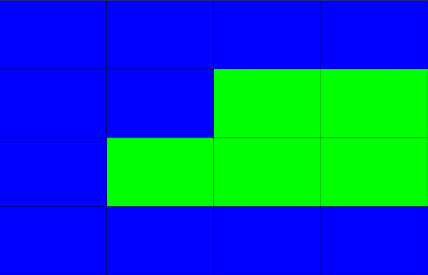
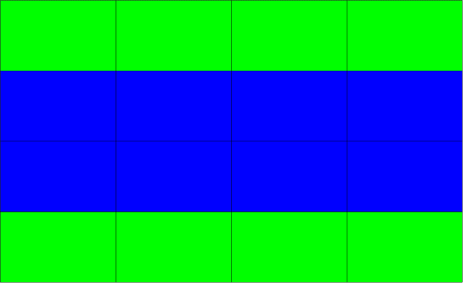
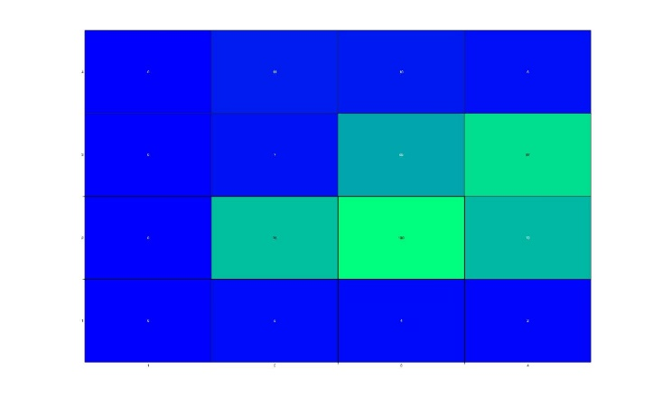
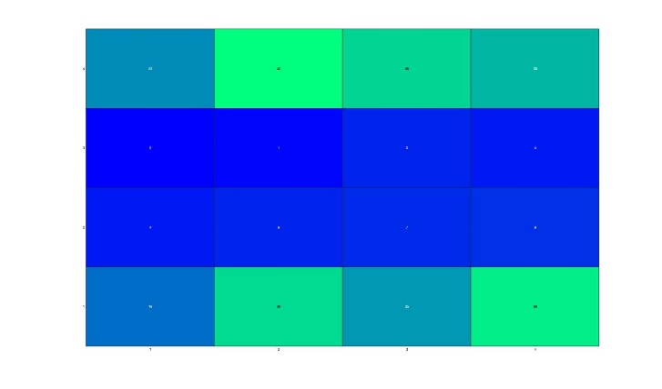
Testing procedure
To approximate a real situation, in which we want to know, how precise the estimation is, we setup multiple random grids. These grids are divided in green and blue boxes, the user is asked to look at the green ones. As we can see in the image above, we have two of these grids on the top and the correspondent heatmap of the result under it.
Bianco-Randazzo Eye tracking and gaze estimation

Slide 14
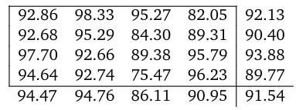
Testing procedure
After this experiment, we tried to estimate the accuracy of our program, by dividing the grid in 16 different blocks and focusing on each of them for 30 seconds, one by one in different experiments. The results are listed below.
In each squared there is the percentage of accuracy of the corresponding square, the last column contains the accuracy of each row, the last row contains the accuracy of each column. The mean accuracy over all the squares is 91.54%.
The accuracy metric doesn’t take care of the points predicted out of the screen.
Bianco-Randazzo Eye tracking and gaze estimation

Slide 15
Discussion
The solution of the gaze prediction showed in this project works good for the shown case. But still, there can be some improvements, which allow to increase performances and accuracy of gaze prediction.
The explained method has significant benefit, because it only requires a web camera to perform gaze estimation.
The experimental results, also show that the proposed method can tolerate slight head movement, which is an important requirement, when integrating head pose information the acquisition with head pose-free gaze estimation.
Moreover, the scaling factor allows to estimate the gaze even if the head distance changes.
By the way, the algorithm suffers from changing the light conditions. In particular case, when the sun points directly to the face, the detection algorithm didn’t performed as desired.
Moreover, our algorithm is strictly dependent from the calibration phase. In the test phase, if the model has not been fed with data from different distances, it won’t be able to track the gaze properly.
Bianco-Randazzo Eye tracking and gaze estimation

Slide 16
Future works
The target of the next task will be to explore head pose-free and calibration-free gaze estimation method.
In future work we propose to find a way to analyze the performances of this solution, in a mathematically and analytically way, since it was not always easy for us to understand how much a change was impacting the overall solution of the problem.
The rotation of the face is not cover by our approach. A solution can be explored using a rotation matrix.
Another important step that can be done to improve our solution, is to change the way to extract the features, with a supervised descent method (SDM) that could lead in a more accurate estimation.
Bianco-Randazzo Eye tracking and gaze estimation

Slide 17
Thank you for listening

